Slide 1
Auto Insurance Offer Assignment Analysis
Tong Yang, Jodie Shue, Tian Wu, Zehui Yun, Zhixing Liu
Notes:
In our project, we are going to dig into the decision process of how an auto insurance company assign different types of offer to its customers and use an analytical approach to assess it decision process and see if we can make policy recommendation to our client.

Slide 2
Agenda
Introduction to the dataset
Objectives
EDA findings
First layer analysis
Second layser analysis
Value opportunity
Conclusion

Slide 3
Introduction To The Dataset
Personal Information | Insurance Information
Customer Lifetime Value | Customer Response
Education Level | Renew Offer Type
Employment status | Option Coverage
Gender | Total Claim Amount
Income | Monthly Premium Auto
Location Code | Sales Channel
Marital Status | Months Since Last Claim
Vehicle Size | Number of Open Complaints
About the Dataset
IBM Watson Analytics
Existing customers’ response to different types of renewed car insurance offer
9134 observations
24 attributes
Notes:
The dataset is gathered from from IBM Watson Analytics. This dataset is focusing on how the existing customers response to different types of renewed auto insurance offer, it totally has 9134 observations and 24 attributes. For preliminary research, we categorized all the attributes into two types. The first type is about customer’s personal information, which includes variables like...the second type is for each customer’s past auto insurance information, the renewed offer assigned to the customer, and customer’s accept or reject response to the offer assignment. These types of attributes include...

Slide 4
Objectives of Our Analysis
Make policy recommendation to the auto insurance company’s current insurance offer assignment decision process.

Slide 5
Exploratory Data Analysis
Two questions to answer:
What kind of attributes the company takes into consideration when it assigns different offers to different customers?
What kind of customers have higher acceptance rate when they are assigned to different types of offer?
Notes:
Our first step is to perform Exploratory data analysis to understand our dataset better, and also we want to identify potentially important features we want to focus on in our later on analysis. There are two questions...

Slide 6
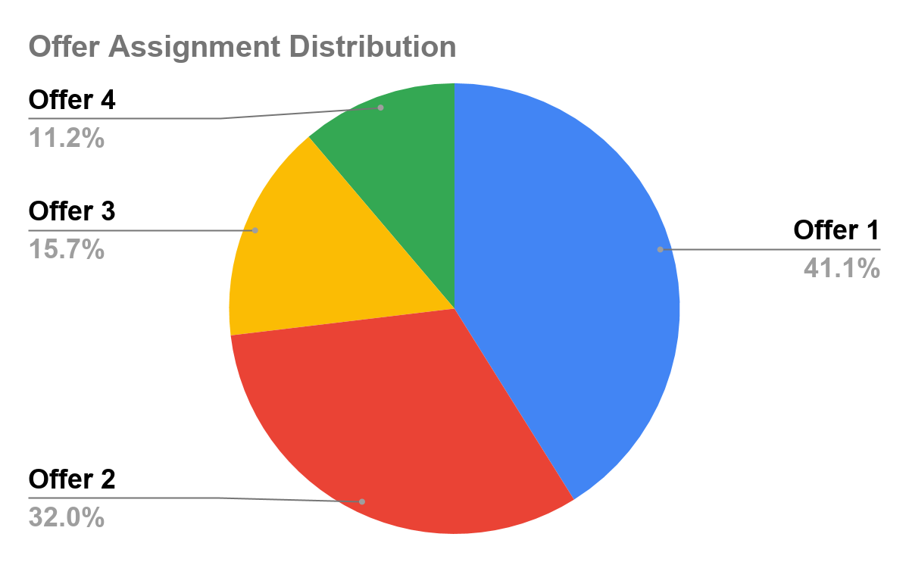
Q1: What kind of attributes the company takes into consideration when it assigns different offers to different customers?
Notes:
By looking at this pie chart we see that offer 1 are mostly assigned by the insurance company, and it made up around 41% of the sample, the next mostly assigned offer is offer 2, which is about 32%, and then next is offer 3 and 4, which are about 15% and 11% respectively

Slide 7
Q1: What kind of attributes the company takes into consideration when it assigns different offers to different customers?
 | Variable name | Mostly assigned offer type
Categorical | Education level | Offer 1: all educational levels except doctor degree (offer 2)
 | Employment status | Offer 2: employed customer Offer 1: unemployed customer
 | Sales channel | Offer 1: agent and branch channels Offer 2: call center and web channels
 | Location code | Offer 1: suburban Offer 1 & 2: rural, urban
 | Marital Status | Offer 2: married Offer 1: single or divorced
Numerical | Customer lifetime value | Offer 1, 3, 2, 4 ( from highest to lowest)
 | Monthly premium auto | Offer 1, 3, 2, 4 ( from highest to lowest)
 | Months since policy inception | Offer 1, 3, 2, 4 ( from highest to lowest)
 | Total claim amount | Offer 1, 3, 2, 4 ( from highest to lowest)
 | Income | Offer 2, 4, 3, 1 ( from highest to lowest)
Notes:
So our first question is...For each categorical variable, we looked into the amount of each offer assigned by categories. If under one variable, a specific offer was mostly assigned to one or multiple categories, we have intuition to believe this variable could be an important factor that the company considered in assigning this type of offer. Then we discovered, offer 1 was assigned mostly to all educational levels, except for doctor degree, most offer 2 were assigned. More employed customers are assigned offer 2 and more unemployed customers are assigned offer 1. When company communicate offer 1 to customers, it most oftenly use agent and branch channels as sales channel and for offer 2, it mostly used call center and web channels. Most offer 1 are assigned to suburban customers, and most offer 2 assigned to rural and urban customers. Most married customers were assigned offer 2 and single or divorced customers were assigned offer 1.
For numerical variables, we take group the data by offer types and look at the group average of each numerical variable. We discovered an interesting pattern that offer 1 group have the higest average customer lifetime. Value, monthly premium auto, months since policy inception and total claim amount, and it followed a pattern of offer 1,3,2,4 group from highest to lowest average value. And for group average income, offer 2 group has the highest among the rest, so we have reason to think that company may put more weight on income when it decides to assign offer2.

Slide 8
Q2: What kind of customers have higher acceptance rate when they are assigned to different types of offer?
 | Variable name | Acceptance rate comparison
Categorical | Education level | Higher educational level, higher acceptance rate
 | Marital status | Divorced > Married > Single
 | Employment status | Employed > Unemployed
 | Location code | Suburban > Rural > Urban
 | Sales channel | Agency > Branch > Web > Call center
 |  | Correlation with acceptance rate
Numerical | Customer lifetime value | Negative
 | Income | Positive
 | Total claim amount | Positive
 | Month since last claim | Negative
Notes:
Second question is ...this time we looked at the acceptance rate under each categorical value, and try to distinguish what kind of customers have higher acceptance rate. We discovered that customer with higher education would be more likely to accept the offer, divorced customers has higher acceptance rate than … customer communicated through agency channel has higher acceptance rate than the other channels. For numerical variables, we tried to look for their correlation with the acceptance rate, and discovered that customers with lower average lifetime value, higher average income, higher average total claim amount, smaller number of months since last claim are more likely to accept the offer.
On interesting finding is that none of the offer 4 were accepted by customers. We are going to consider this issue in our later-on analysis.

Slide 9
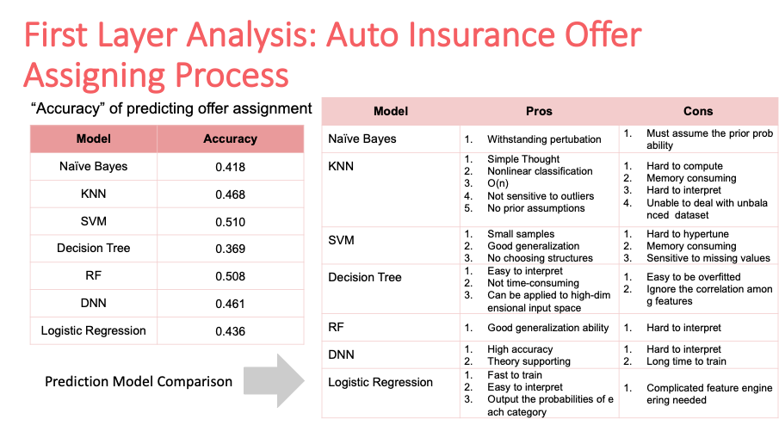

Slide 10
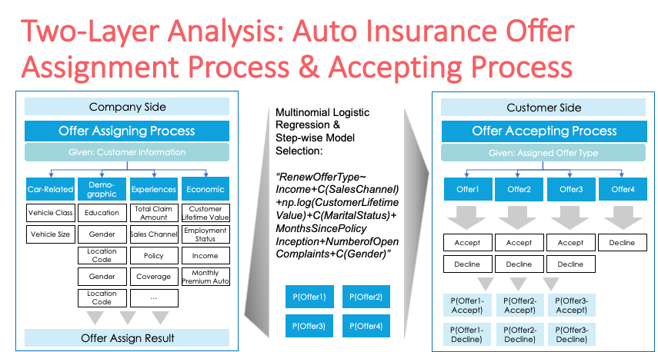
Notes:
After determining that the decision process should be flexible, we decided to utilize logistic regression for two reasons, first, it can provide not only the classification results but the probabilities of each categories; second, it can be interpreted since it provides the weights of each covariates. In this case, we utilized multinomial logistic regression model to fit the insurance offer assigning process.
In this model, integrating the fours aspects of features – car related factors, demographic factors, past experiences factors and economic factors, we aimed to get the possibilities of assigning offer1, offer2, offer3 and offer4 using multinomial logistic regression model. In order to obtain the best model, we integrated different features in our model training process with step-wise model selection method, and then selected the best model based on AIC/BIC level. So our final multinomial logistic regression model is related to the factors including customer income, sales channel, customer lifetime value, marital status, months since policy inception, number of open complaints and gender. Therefore, when given a customer’s information, we can get the possibilities of this customer being assigned offer 1, 2, 3 and 4 with our final multinomial logistic regression model.
Looking from the customers’ perspective, after assigning different offer, it is the customer’s choice to decide whether to accept or not. Then it comes to our second layer analysis.

Slide 11
Second Layer Analysis
Objectives of this part:
We were interested in enhancing the overall acceptance rate and aimed to get a higher expected value of customer lifetime value.
The goal of this part is to predict the acceptance rate of customers when given different offers.
Notes:
Now we come to our second layer analysis.
Since we want to enhance the overall acceptance rate and get a higher expected value of customer lifetime value, we need to construct suitable models to help predict the acceptance rate given different offers.

Slide 12
Second Layer Analysis
Structure:
Feature Engineering: Figured out the general factors that will affect the insurance acceptance
Model Selection: Conducted the method of forward selection among the candidate factors to find the logit model with the best predictive effect of different offers
Prediction Process: Combined the offer assigning probability we got from the first layer and the acceptance rate from the second layer, we can get the total acceptance rate of each customer by the law of total probability.
Notes:
First, we need to select candidate factors that will affect the insurance acceptance rate.
Second, we should find out the best predictive models of each offers’ acceptance probability.
Finally, we could use the simulation result from layer one to conduct prediction analysis, which in turn will help us give business recommendations.

Slide 13
1: Feature Engineering
Factor Types | Demographic Factors | Car-related Factors | Company-related Strategies
Factors | Education Level | Vehicle Size | Sales Channel
 | Marital Status | Vehicle Class | Policy
 | Location | Policy Type | Months Since Last Claim
 | Income |  | log(Total Claim Amount)
 | Employment Status
 | Gender
 | State
Notes:
First, in the feature engineering part, from papers and reports, we learnt that the factors affecting insurance acceptance rate could be divided into 3 general types, demographic factors, car-related factors and company-related strategies.
Combined with the results in Exploratory Data Analytics part, we chose factors in these three types accordingly and presented all of the candidate factors in this chart.

Slide 14
2: Model Selection: Offer 1
Strategy: Conducted the method of forward selection among the candidate factors to find the logit model with the lowest AIC.
Factors in the final prediction model of offer 1:
Factor Types | Demographic Factors | Car-related Factors | Company-related Strategies
Factors | Education Level | Vehicle Size | Sales Channel
 | Marital Status | Vehicle Class | log(Total Claim Amount)
 | Location
 | Employment Status
 | State
Notes:
Second, for model selection part, since no one accepted offer 4 in our dataset, we only constructed models to predict the acceptance rate of customers when given offer1, offer2 and offer3.
In this part, we separately conducted the method of forward selection among the candidate factors to find the logit model with the lowest AIC, which means the highest predictive effect.
Following this strategy, we got the best prediction model for offer 1. In this model, 5 factors in the Demographic Factors, 2 factors in Car-related Factors and 2 factors in Company-related Strategies will influence the acceptance probability if the customers are assigned with offer 1.

Slide 15
2: Model Selection: Offer 2
Strategy: Conducted the method of forward selection among the candidate factors to find the logit model with the lowest AIC.
Factors in the final prediction model of offer 2:
Factor Types | Demographic Factors | Car-related Factors | Company-related Strategies
Factors | Education Level | Vehicle Size | Sales Channel
 | Marital Status | Policy Type
 | Location
 | Income
 | State
Notes:
When analyzing the best prediction model for offer 2 by forward selection, we found out that the final factors in this model are different from that of the best model when assigned with offer 1.
Here in the Demographic Factors part, we don’t have Employment Status but we have Income as an influencial factor; Policy Type took the place of Vehicle Class in the Car-related Factors; and Company-related Strategies only have sales channel to influence the acceptance probability if the customers are assigned with offer 2.

Slide 16
2: Model Selection: Offer 3
Strategy: Conducted the method of forward selection among the candidate factors to find the logit model with the lowest AIC.
Factors in the final prediction model of offer 3:
Factor Types | Demographic Factors | Car-related Factors | Company-related Strategies
Factors | Education Level | Vehicle Size | Sales Channel
 | Gender |  | Months Since Last Claim
 | State
Notes:
Analysis of offer3 is special to some extent because with a sample size of 1432, only 30 customers accept the offer. To successfully conduct logistic regression, we eliminated 5 candidate factors which are Marital Status, Sales Channel, Vehicle Class, Income, Months Since Last Claim because of their lack of variance in the database.
Finally we got 6 factors in total to formulate our final prediction model of offer 3.
Given the results above, we can conclude that while being assigned with different offers, customers decision will be influenced by different factors. This can further help improve the offer assigning process.

Slide 17
3: Prediction Process
First Layer
Offer-Assigning Probability
Conditional Probability of Accepting Different Offers
Second Layer
Total Acceptance Rate
Value Prediction
Total Acceptance Rate
Customer Lifetime Value
Notes:
Since our final goal is to try different assignment method then find the best model to reach the highest mean value, we need to predict the acceptance probability of different offer-assigning strategy.
Based on the offer assigning probability we got from the first layer, we can get the total acceptance rate of each customer by the law of total probability. Then we could get the expected value of each customer by multiplying the total acceptance rate and the customer lifetime value.

Slide 18
Value Opportunity
Factors |  |  |  |  |  |  |  | Total Acceptance Rate | Mean Customer Lifetime Value
Iteration 1 | Income | Sales Channel | Customer Lifetime Value | Marital Status | Month Since Policy Inception | Number of Open Complaints | Gender | 0.15133861120153308 | 1246.1344347985264
Iteration 2 | Factors Affecting Acceptance rate of Offer 1 |  |  |  |  |  |  | 0.15358125941635387 | 1273.862539033336
Iteration 3 | Factors Affecting Acceptance rate of Offer 2 |  |  |  |  |  |  | 0.15219227310163025 | 1264.5132920624455
Iteration 4 | Factors Affecting Acceptance rate of Offer 3 |  |  |  |  |  |  | 0.14698256333996293 | 1219.307550980015

Slide 19
Conclusion

Slide 20
Further Work
Recommend the company to incorporate company-related factors into offer assigning process
Stochastic programming optimization models could be established to optimize the assigning process; scenario-based algorithms can be utilized to solve the model
Conduct more research on the demographic and economic influencing factors of the car insurance industry
A/B testing techniques can be used to test whether the recommendations can improve the profit the car insurance company

